Slide 1
Unit 2-Introduction to Search

Slide 2
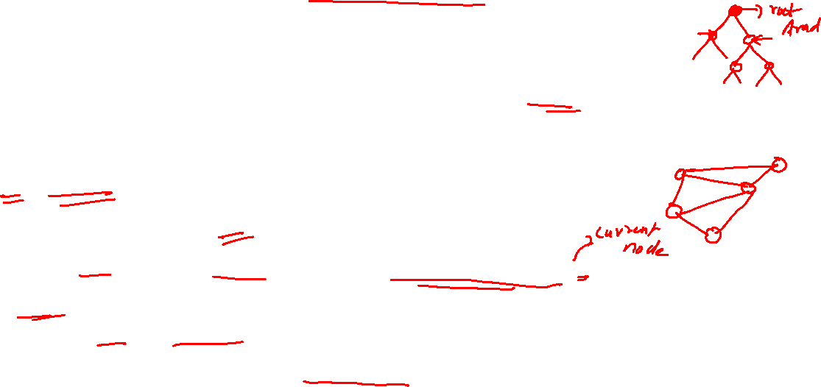
Searching for Solutions
Solutions: found by using search techniques that explicitly search through the state space.
Search tree used for this
For e.g consider the problem of travelling from Arad to Bucharest
Root of the search tree is the search node corresponding to the start state
x=In(Arad)
Is x the goal state (yes or no)?
If yes stop else expand(apply the SUCCESSOR_FN(x))
Frontier: set of all leaf nodes available for expansion at a given point of time(open list or fringe)
Process of expanding the frontier continues until you reach the goal node or there are no more nodes to expand

Slide 4
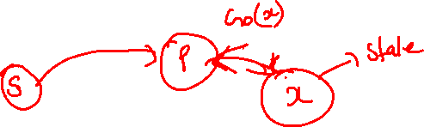
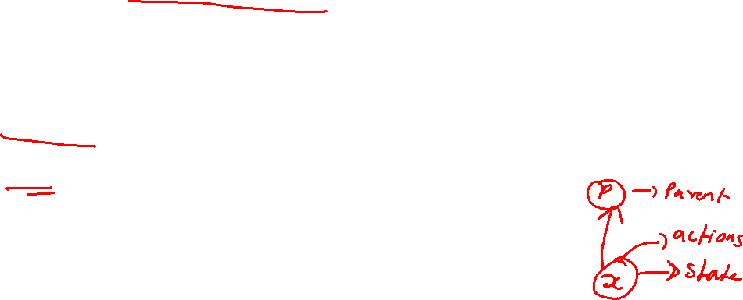
Data Structure for a search algorithm:
5 components:
STATE: state in the state space to which the node corresponds
PARENT-NODE: the node in the search tree that generated this node
ACTION: the action that was applied to the parent to generate the node
PATH-COST: the cost, of the path from the initial state to the node.
DEPTH: the number of steps along the path from the initial state

Slide 5



Slide 6

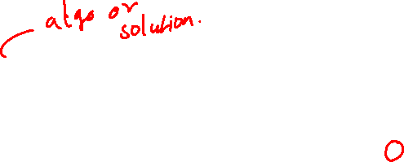
Evaluation
Search Trees are evaluated based on :
Completeness : does it always find a solution if one exist
Time complexity: No. of nodes generated
Space complexity: maximum number of nodes in memory
Optimality: does it always find a least cost solution
Systematicity: does it visit each state at most once
Three symbols used to measure time and space complexity are
b: maximum branching factor of the search tree (how many actions can I take)
d: depth of the least cost solution (at root depth is 0)
m: maximum depth of the state space(maybe infinity) (no. of levels)

Slide 7
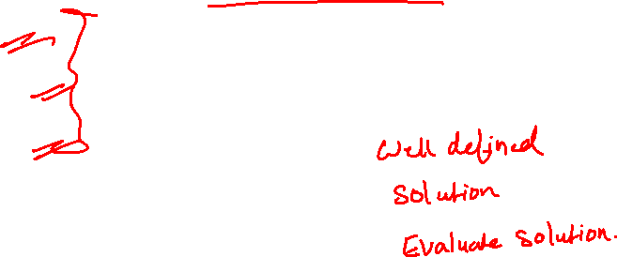
Uninformed search(blind search) strategies
Only information available is the problem definition
Depth first search
Breadth first search
Uniform cost search
Depth limited search
Iterative deepening depth first search
Bidirectional search

Slide 8
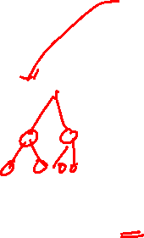

Depth first search:
Always expand
the deepest node
Goes depth wise
And completes the
Sub tree
Rule 1 − Visit the adjacent unvisited vertex. Mark it as visited. Display it. Push it in a stack.
Rule 2 − If no adjacent vertex is found, pop up a vertex from the stack. (It will pop up all the vertices from the stack, which do not have adjacent vertices.)
Rule 3 − Repeat Rule 1 and Rule 2 until the stack is empty.

Slide 9


Every node you ask the question is this the goal
If say M is the goal the path is A->C->F->M
Evaluation:
Completeness
Does it always find a solution, if one exists?
Is it complete?
If branching factor b finite yes else no.
What if a certain subtree never ends, and the goal is on another subtree?
2)Time Complexity
No. of nodes generated
Exponential growth
Worst case: goal is in the last subtree, full size of the sub tree b^{m}
O(b^{m})
b:maximum branching factor
m:maximum depth (no. of levels)

Slide 10
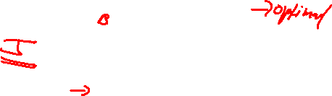
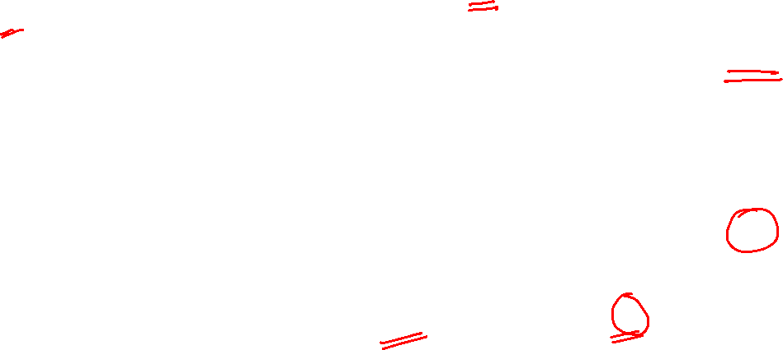
3)Space Complexity
What must be stored in memory?
All children of every node in the path must be stored
Information on whether they have been visited must also be stored
Maximum length of the path is given by m
For each node the no. of children is given b
O(bm)
If I know the order in which the children are arranged, then O(m)
4)Optimal
Does it always find the least cost solution
Not optimal
What if there are two goal states J and C
Once it reaches J, DFS would return it as a
a solution and will stop
C is the solution with the least cost
Stack is used for the implementation

Slide 11

Breadth First Search
Evaluation:
1) Completeness
Is it complete?
If b finite yes
2) Time Complexity
Maximum depth if d and b is the branching factor
O(b^{d})

Slide 12


3) Space Complexity
O(b^{d})
4) Optimal
If all steps cost same, it is optimal (Uniform Cost search)
Queue is used for implementing

Slide 13

Uniform Cost Search
Expand the cheapest node first
Goes to all directions or expands in all
directions and finds an optimal solution.
A
B
C
D
E
F
G
H
A->B | 1
A->C | 5
B->D | 2
B->E | 6
C->F | 1
C->G | 3
C->H | 4

Slide 14
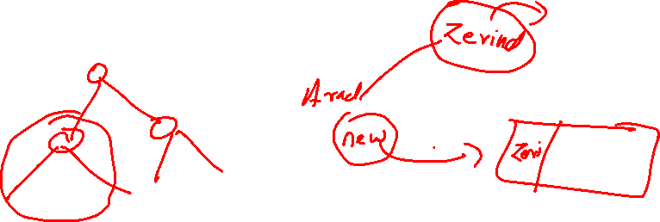
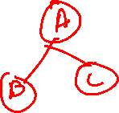
Avoiding Repeated States
For some problems repeated states never occur, for some they are unavoidable
Eliminating repeated states reduces the cost of the search
We can prune the repeated states to cut down the search tree to a finite size thereby reducing the cost

